Slide 1
Introduction to git
Viktor Andersson
viktor.andersson@activesolution.se

Slide 2
TFVC vs git
Centralised vs Distributed
Centralised version control
A server has control of the repository
A client checks out a snapshot
A client can ”lock” a file to prevent anyone else from making changes
Distributed version control
Each client has the full repository on their computer
The client pushes their changes to a central repository

Slide 3
Git Basics
local repository
push
local history
remote repository
commit
stage
clone
checkout
pull
fetch
add
working directory

Slide 4
How git stores files
Many other VCS store differences of files
Pro Git book https://git-scm.com/book/en/v2

Slide 5
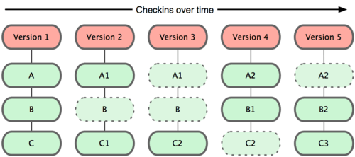
How git stores files
Git stores snapshots
Pro Git book https://git-scm.com/book/en/v2

Slide 6
What’s in a commit
A commit consists of two things:
A pointer to the snapshot of your code
Pointers to any ”parent” commits
5971c226: Add first files
snapshot
parent
61eb8561: Update file
snapshot
parent
998aa403: Add another file
snapshot

Slide 7
branches
Branches in git are very light-weight
Create many branches

Slide 8
working with branches
use the master branch for releases
any new development is done in a new branch:
feature/support-new-language
feature/add-unit-tests
bugfix/1234-cannot-open-file
when development is done the branch is merged into the master branch

Slide 9
working with branches 2
use a master branch for releases
use a develop branch for ongoing work
still use feature- and bug-branches starting from develop and merge them back to develop
when develop is ready for release it is merged into master
with this approach it is possible to do hotfixes directly on master

Slide 10
Demo

Slide 11
.gitignore
.gitignore is a file in the root-folder of the repository that tells git what files to ignore, e.g. binaries and executables
https://gitignore.io/ is a good source for a template to start with

Slide 12
git-credential-manager
Provides secure storage of git credentials to keep git from asking for your password all the time
If it’s not installed by default, install it from https://github.com/Microsoft/Git-Credential-Manager-for-Windows
Activate caching with the command
git config –global credential.helper cache
Stores the credentials in the Windows Credential Store

Slide 13
Hands-on lab
Instructions: https://github.com/activesolution/introduction-to-git

Slide 14
Tips to avoid tough merge conflicts
Keep your commits small and commit often
No, more often than that
Don’t be afraid to create many branches
if you want to experiment, create a branch
Try to avoid long-living branches
Keep the branch up-to-date with its parent branch

Slide 15
GUI clients
https://www.sourcetreeapp.com/
https://desktop.github.com/
https://gitextensions.github.io/
https://git-fork.com/
https://git-scm.com/downloads/guis/

Slide 16
Useful links
https://learngitbranching.js.org/
https://marklodato.github.io/visual-git-guide/index-en.html
http://think-like-a-git.net/
https://gitignore.io/
https://github.com/Microsoft/Git-Credential-Manager-for-Windows

